Slide 1
EXCEPTION HANDLING AGENDA

Slide 2
14.throw keyword
15.throws keyword
16.Exception handling keywords summary
17.Various possible compile time errors in exception handling
18.Customized exceptions
19.Top-10 exceptions
20.1.7 Version Enhancements
1. try with resources
2. multi catch block
21.Exception Propagation
22.Rethrowing an Exception“
1. Introduction
2. Runtime stack mechanism
3. Default exception handling in java
4. Exception hierarchy
5. Customized exception handling by try catch
6. Control flow in try catch
7. Methods to print exception information
8. Try with multiple catch blocks
9. Finally
10.Difference between final, finally, finalize
11.Control flow in try catch finally
12.Control flow in nested try catch finally
13.Various possible combinations of try catch finally

Slide 3

INTRODUCTION

Slide 4

Exception
An unwanted unexpected event that disturbs normal flow of the program is
called exception.
Example:
SleepingException
TyrePunchuredException
FileNotFoundException ...etc
• It is highly recommended to handle exceptions. The main objective of exception
handling is graceful (normal) termination of the program.
What is the meaning of exception handling?
Exception handling doesn't mean repairing an exception. We have to define alternative
way to continue rest of the program normally. This way of defining alternative is nothing but exception handling.

Slide 5
Example: Suppose our programming requirement is to read data from remote file locating at London. At runtime if London file is not available then our program should not be terminated abnormally.
We have to provide a local file to continue rest of the program normally. This way of defining alternative is nothing but exception handling.
For every thread JVM will create a separate stack at the time of Thread creation. All
method calls performed by that thread will be stored in that stack. Each entry in the
stack is called "Activation record" (or) "stack frame".
After completing every method call JVM removes the corresponding entry from the stack.
Example:
try
{
read data from London file
}
catch(FileNotFoundException e)
{
use local file and continue rest of the program normally
}
After completing all method calls JVM destroys the empty stack and terminates the program normally.
3

Slide 6
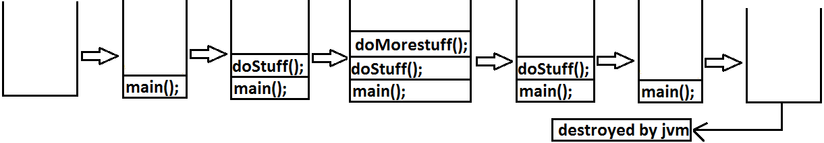
Example:
class Test
{
public static void main(String[] args){
doStuff();
}
public static void doStuff(){
doMoreStuff();
}
public static void doMoreStuff(){
System.out.println("Hello");
}}
Output:
Hello
4

Slide 7

Default Exception Handling in Java

Slide 8
If an exception raised inside any method then that method is responsible to
create Exception object with the following information.
1. Name of the exception.
2. Description of the exception.
3. Location of the exception. (StackTrace)
2. After creating that Exception object, the method handovers that object to the JVM.
3. JVM checks whether the method contains any exception handling code or not. If method won't contain any handling code then JVM terminates that method abnormally and removes corresponding entry form the stack.
4. JVM identifies the caller method and checks whether the caller method contain
any handling code or not. If the caller method also does not contain handling
code then JVM terminates that caller method also abnormally and removes
corresponding entry from the stack.
5. This process will be continued until main() method and if the main() method also
doesn't contain any exception handling code then JVM terminates main()
method also and removes corresponding entry from the stack.
6. Then JVM handovers the responsibility of exception handling to the default exception handler.
7. Default exception handler just print exception information to the console in the
following format and terminates the program abnormally.
4

Slide 9
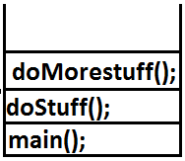
Exception in thread “xxx(main)” Name of exception: description
Location of exception (stack trace)
Example:
class Test
{
public static void main(String[] args){
doStuff();
}
public static void doStuff(){
doMoreStuff();
}
public static void doMoreStuff(){
System.out.println(10/0);
}}
Output:
Exception in thread "main" java.lang.ArithmeticException: / by zero
atTest.doMoreStuff(Test.java:10)
atTest.doStuff(Test.java:7)
atTest.main(Test.java:4)

Slide 10

Exception Hierarchy

Slide 11
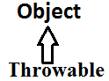
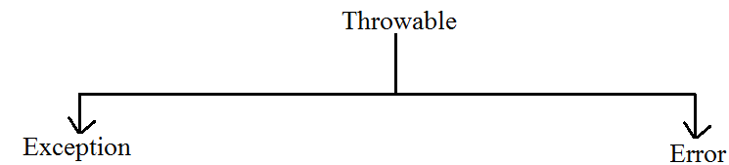
Exception:
Most of the cases exceptions are caused by our program and these are recoverable.
Ex : If FileNotFoundException occurs then we can use local file and we can continue
rest of the program execution normally.
Throwable acts as a root for exception hierarchy.
Throwable class contains the following two child classes.
Error:
Most of the cases errors are not caused by our program these are due to lack of system
resources and these are non-recoverable.
Ex :If OutOfMemoryError occurs being a programmer we can't do anything the
program will be terminated abnormally. System Admin or Server Admin is responsible to raise/increase heap memory.
5

Slide 12
Checked Vs Unchecked Exceptions
Note:RuntimeException and its child classes, Error and its child classes are unchecked and all the remaining are considered as checked exceptions.
Note: Whether exception is checked or unchecked compulsory it should occurs at runtime only and there is no chance of occurring any exception at compile time.
• The exceptions which are checked by the compiler whether programmer
handling or not, for smooth execution of the program at runtime, are called
checked exceptions.
1. HallTicketMissingException
2. PenNotWorkingException
3. FileNotFoundException
• The exceptions which are not checked by the compiler whether programmer
handing or not ,are called unchecked exceptions.
1. BombBlastException
2. ArithmeticException
3. NullPointerException
6

Slide 13
Fully checked Vs Partially checked
Q: Describe behavior of following exceptions ?
1. RuntimeException-----unchecked
2. Error-----unchecked
3. IOException-----fully checked
4. Exception-----partially checked
5. InterruptedException-----fully checked
6. Throwable------partially checked
7. ArithmeticException ----- unchecked
8. NullPointerException ------ unchecked
9. FileNotFoundException ----- fully checked
checked.
Example:
1) IOException
2) InterruptedException
A checked exception is said to be partially checked if and only if some of its child classes
are unchecked.
Example:
Exception
Note :The only possible partially checked exceptions in java are:
1. Throwable.
2. Exception.
7

Slide 14
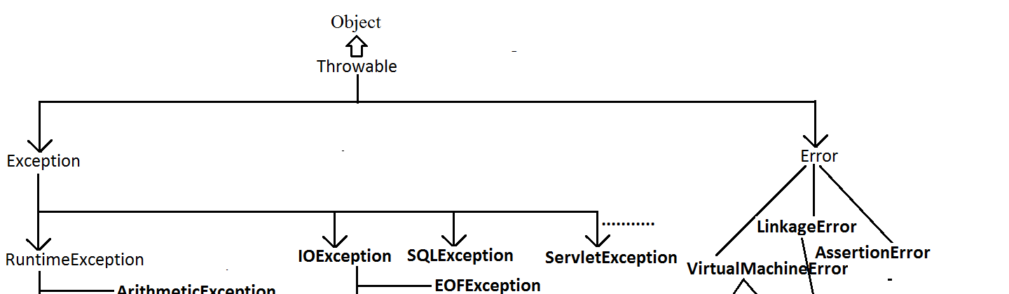
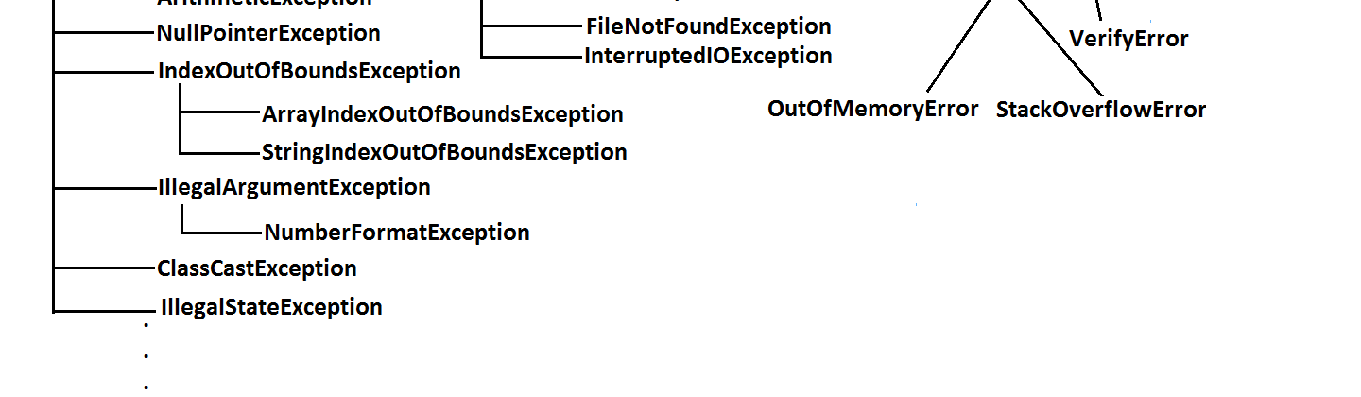

Slide 15
Customized Exception Handling by using try-catch
• It is highly recommended to handle exceptions.
• In our program the code which may raise exception is called risky code, we have
to place risky code inside try block and the corresponding handling code inside catch block.
Example:
try
{
Risky code
}
catch(Exception e)
{
Handling code
}
8

Slide 16
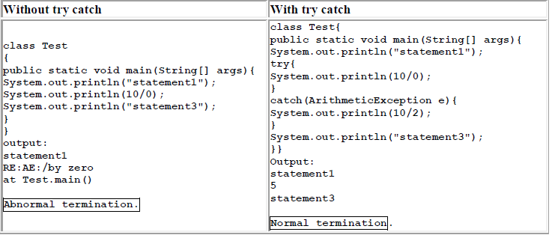

Slide 17

Control flow in try catch

Slide 18
try{
statement1;
statement2;
statement3;
}
catch(X e) {
statement4;
}
statement5;
• Case 4:if an exception raised at statement 4 or statement 5 then it's always
abnormal termination of the program.
Note:
1. Within the try block if anywhere an exception raised then rest of the try block
won't be executed even though we handled that exception. Hence we have to place/take only risk code inside try block and length of the try block should be as less as possible.
2. If any statement which raises an exception and it is not part of any try block then it is always abnormal termination of the program.
3. There may be a chance of raising an exception inside catch and finally blocks
also in addition to try block.
• Case 1:If there is no exception.
1, 2, 3, 5 normal termination.
• Case 2: if an exception raised at statement 2 and corresponding catch block
matched
1, 4, 5 normal termination.
• Case 3: if an exception raised at statement 2 but the corresponding catch block
not matched
1 followed by abnormal termination.
9

Slide 19

Various methods to print exception information

Slide 20
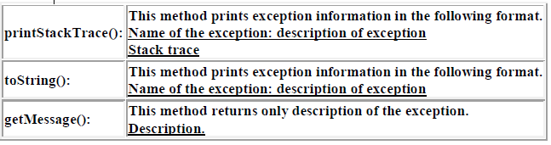
Throwable class defines the following methods to print exception information to the console.

Slide 21
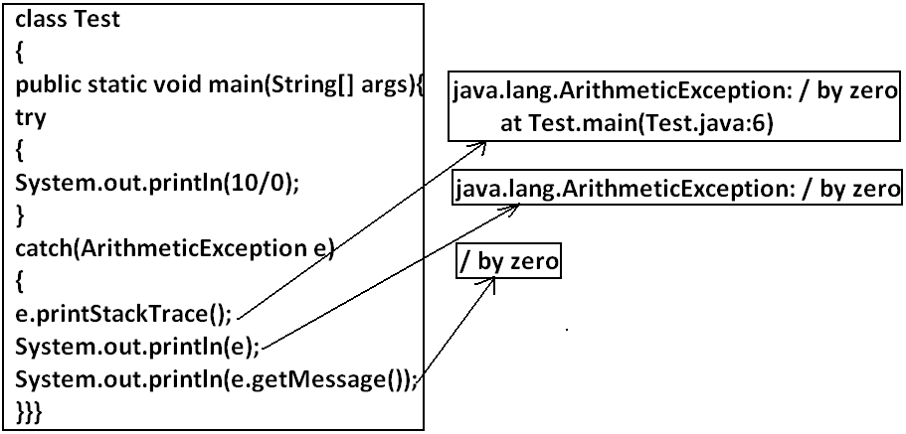
Note: Default exception handler internally uses printStackTrace() method to print exception information to the console.
10

Slide 22
Try with multiple catch blocks

Slide 23
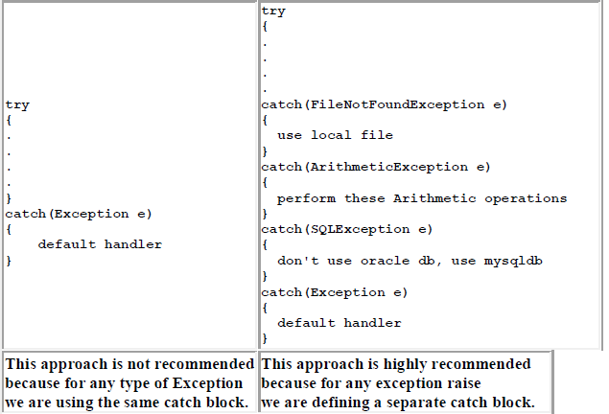
The way of handling an exception is varied from exception to exception. Hence for every
exception type it is recommended to take a separate catch block. That is try with
multiple catch blocks is possible and recommended to use.
10

Slide 24
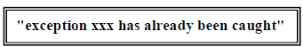
• If try with multiple catch blocks present then order of catch blocks is very
important. It should be from child to parent by mistake if we are taking from
parent to child then we will get Compile time error saying
11

Slide 25
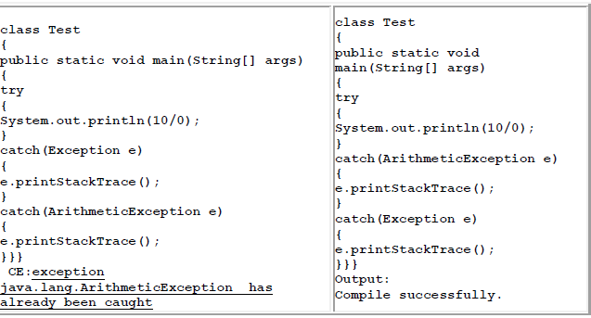
11

Slide 26


Finally block

Slide 27

• It is not recommended to take clean up code inside try block because there is no
guarantee for the execution of every statement inside a try.
• It is not recommended to place clean up code inside catch block because if there
is no exception then catch block won't be executed.
• We require some place to maintain clean up code which should be executed
always irrespective of whether exception raised or not raised and whether
handled or not handled. Such type of best place is nothing but finally block.
• Hence the main objective of finally block is to maintain cleanup code.

Slide 28
Case-1: If there is no Exception:
class Test
{
public static void main(String[] args)
{
try
{
System.out.println("try block executed");
}
catch(ArithmeticException e)
{
System.out.println("catch block executed");
}
finally
{
System.out.println("finally block executed");
}
}
}
Output:
try block executed
Finally block executed
try
{
risky code
}
catch(x e)
{
handling code
}
finally
{
cleanup code
}
The speciality of finally block is it will be executed always irrespective of whether the exception raised or not raised and whether handled or not handled.
12

Slide 29
Case-2: If an exception raised but the corresponding catch
block matched:
class Test
{
public static void main(String[] args)
{
try
{
System.out.println("try block executed");
System.out.println(10/0);
}
catch(ArithmeticException e)
{
System.out.println("catch block executed");
}
finally
{
System.out.println("finally block executed");
}
}
}
Output:
Try block executed
Catch block executed
Finally block executed
13

Slide 30
Case-3: If an exception raised but the corresponding catch
block not matched:
class Test
{
public static void main(String[] args)
{
try
{
System.out.println("try block executed");
System.out.println(10/0);
}
catch(NullPointerException e)
{
System.out.println("catch block executed");
}
finally
{
System.out.println("finally block executed");
}
}
}
Output:
Try block executed
Finally block executed
Exception in thread "main" java.lang.ArithmeticException: / by zero
atTest.main(Test.java:8)
13

Slide 31
{
System.out.println("catch block executed");
}
finally
{
System.out.println("finally block executed");
}
}}
Output:
try block executed
Finally block executed
return Vs finally:
Even though return statement present in try or catch blocks first finally will be executed
and after that only return statement will be considered. i.efinally block dominates return statement
class Test
{
public static void main(String[] args)
{
try
{
System.out.println("try block executed");
return;
}
catch(ArithmeticException e)
14

Slide 32
If return statement present try, catch and finally blocks then finally block return
statement will be considered.
Example:
class Test
{
public static void main(String[] args)
{
System.out.println(m1());
}
public static intm1(){
try
{
System.out.println(10/0);
return 777;
}
catch(ArithmeticException e)
{
return 888;
}
finally{
return 999;
}
}}
Output:
999
14

Slide 33
Example:
class Test
{
public static void main(String[] args)
{
try
{
System.out.println("try");
System.exit(0);
}
catch(ArithmeticException e)
{
System.out.println("catch block executed");
}
finally
{
System.out.println("finally block executed");
}
}}
Output:
try
finally vs System.exit(0):
==========================
There is only one situation where the finally block won't be executed is whenever we are
using System.exit(0) method.
When ever we are using System.exit(0) then JVM itself will be shutdown , in this case
finally block won't be executed.
i.e., System.exit(0) dominates finally block.

Slide 34
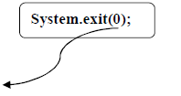
1. This argument acts as status code. Insteadof zero, we can take any integer value
2. zero means normal termination , non-zero means abnormal termination
3. This status code internally used by JVM, whether it is zero or non-zero there is no
change in the result and effect is same wrt program.

Slide 35

Difference between final, finally, and finalize

Slide 36
finalize:
• finalize is a method, always invoked by Garbage Collector just before destroying
an object to perform cleanup activities.
final:
• final is the modifier applicable for classes, methods and variables.
• If a class declared as the final then child class creation is not possible.
• If a method declared as the final then overriding of that method is not possible.
• If a variable declared as the final then reassignment is not possible.
Note:
1. finally block meant for cleanup activities related to try block where as finalize()
method meant for cleanup activities related to object.
2. To maintain clean up code finally block is recommended over finalize() method
because we can't expect exact behavior of GC.
finally:
• finally is the block always associated with try-catch to maintain clean up code
which should be executed always irrespective of whether exception raised or not
raised and whether handled or not handled.
16

Slide 37

Control flow in try catch finally

Slide 38

try
{
Stmt 1;
Stmt-2;
Stmt-3;
}
catch(Exception e)
{
Stmt-4;
}
finally
{
stmt-5;
}
Stmt-6;
▪ Case 1: If there is no exception. 1, 2, 3, 5, 6 normal termination.
▪ Case 2: if an exception raised at statement 2 and corresponding catch block matched. 1,4,5,6 normal terminations.
▪ Case 3: if an exception raised at statement 2 and corresponding catch block is not matched. 1,5 abnormal termination.
▪ Case 4: if an exception raised at statement 4 then it's always abnormal termination but before the finally block will be executed.
▪ Case 5: if an exception raised at statement 5 or statement 6 its always abnormal termination.
16

Slide 39

Control flow in Nested try-catch-finally

Slide 40
try
{
stmt-1;
stmt-2;
stmt-3;
try
{
stmt-4;
stmt-5;
stmt-6;
}
catch (X e)
{
stmt-7;
}
finally
{
stmt-8;
}
stmt-9;
}
catch (Y e)
{
stmt-10;
}
finally
{
stmt-11;
}
stmt-12;
17

Slide 41
Case 1:if there is no exception. 1, 2, 3, 4, 5, 6, 8, 9, 11, 12 normal termination.
▪ Case 2: if an exception raised at statement 2 and corresponding catch block matched
1,10,11,12 normal terminations.
▪ Case 3: if an exception raised at statement 2 and corresponding catch block is not
matched 1, 11 abnormal termination.
▪ Case 4: if an exception raised at statement 5 and corresponding inner catch has
matched 1, 2, 3, 4, 7, 8, 9, 11, 12 normal termination.
▪ Case 5: if an exception raised at statement 5 and inner catch has not matched but
outer catch block has matched. 1, 2, 3, 4, 8, 10, 11, 12 normal termination.
▪ Case 6: if an exception raised at statement 5 and both inner and outer catch blocks
are not matched. 1, 2, 3, 4, 8, 11 abnormal termination
▪ Case 7: if an exception raised at statement 7 and the corresponding catch block
matched 1, 2, 3, 4, 5, 6, 8, 10, 11, 12 normal termination.
▪ Case 8: if an exception raised at statement 7 and the corresponding catch block not
matched 1, 2, 3, 4, 5, 6, 8, 11 abnormal terminations.
17

Slide 42
▪ Case 9:if an exception raised at statement 8 and the corresponding catch block has
matched 1, 2, 3, 4, 5, 6, 7, 10, 11,12 normal termination.
▪ Case 10: if an exception raised at statement 8 and the corresponding catch block not
matched 1, 2, 3, 4, 5, 6, 7, 11 abnormal terminations.
▪ Case 11: if an exception raised at statement 9 and corresponding catch block
matched 1, 2, 3, 4, 5, 6, 7, 8,10,11,12 normal termination.
▪ Case 12: if an exception raised at statement 9 and corresponding catch block not
matched 1, 2, 3, 4, 5, 6, 7, 8, 11 abnormal termination.
▪ Case 13: if an exception raised at statement 10 is always abnormal termination but before that finally block 11 will be executed.
▪ Case 14: if an exception raised at statement 11 or 12 is always abnormal
termination.
18

Slide 43
Note:
1.if we are not entering into the try block then the finally block won't be executed. Once
we entered into the try block without executing finally block we can't come out.
2. We can take try-catch inside try i.e., nested try-catch is possible
3. The most specific exceptions can be handled by using inner try-catch and generalized
exceptions can be handle by using outer try-catch.
}
finally{
String s=null;
System.out.println(s.length());
}
}}
output :
RE:NullPointerException
Example:
class Test
{
public static void main(String[] args){
try{
System.out.println(10/0);
}
catch(ArithmeticException e)
{
System.out.println(10/0);
Note: Default exception handler can handle only one exception at a time and that is the most recently raised exception.
18

Slide 44

Various possible combinations of try catch finally
“

Slide 45


1. Whenever we are writing try block compulsory we should write either catch or
finally. i.e., try without catch or finally is invalid.
2. Whenever we are writing catch block compulsory we should write try.
i.e., catch without try is invalid.
3. Whenever we are writing finally block compulsory we should write try.
i.e., finally without try is invalid.
4. In try-catch-finally order is important.
5. With in the try-catch -finally blocks we can take try-catch-finally.
i.e., nesting of try-catch-finally is possible.
6. For try-catch-finally blocks curly braces are mandatory
18

Slide 46
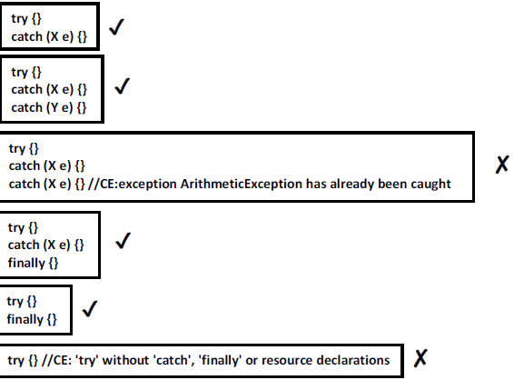
19

Slide 47
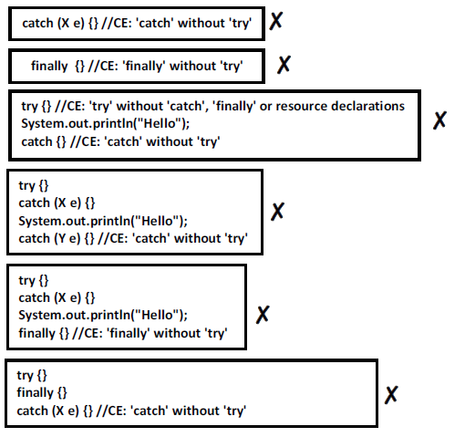
19

Slide 48
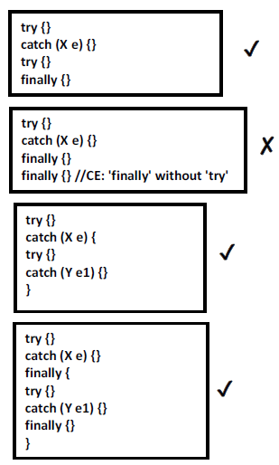
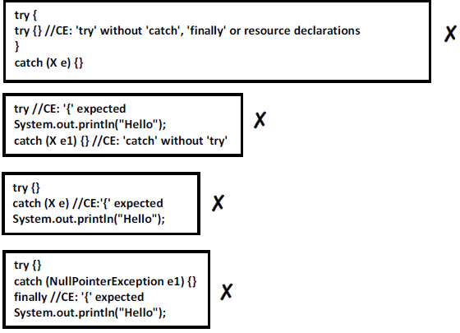
20

Slide 49
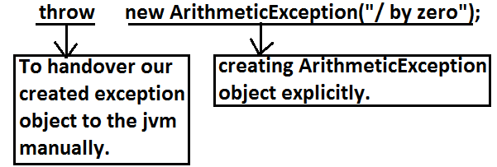

throw statement:
Sometimes we can create Exception object explicitly and we can hand over to the JVM
manually by using throw keyword
21

Slide 50
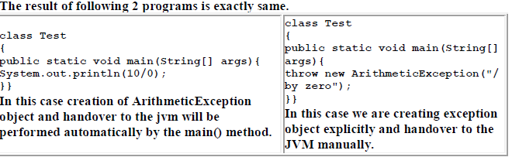
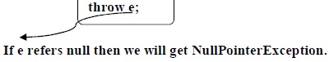
Case 1:
Note: In general we can use throw keyword for customized exceptions but not for predefined exceptions.
21

Slide 51
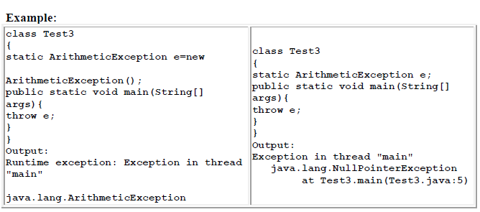
22

Slide 52
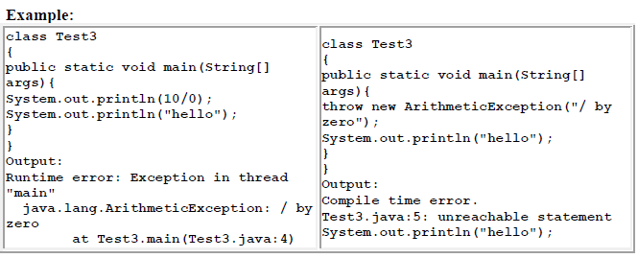
Case 2:
After throw statement we can't take any statement directly otherwise we will get compile time error saying unreachable statement.
22

Slide 53
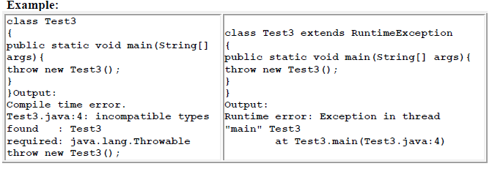
Case 3:
We can use throw keyword only for Throwable types otherwise we will get compile time
error saying incomputable types.
22

Slide 54
Throws statement
21

Slide 55
In our program if there is any chance of raising checked exception then compulsory we
should handle either by try catch or by throws keyword otherwise the code won't compile.
Example:
class Test3
{
public static void main(String[] args){
Thread.sleep(5000);
}
}
//
Example:
import java.io.*;
class Test3
{
public static void main(String[] args){
PrinterWriter out=new PrintWriter("abc.txt");
out.println("hello");
}
}
CE:
Unreported exception java.lang.InterruptedException; must be caught or
declared to be thrown.
When you put a thread to sleep using Thread.sleep(), the thread enters a blocked state for the specified time. If, during this blocked state, another thread calls interrupt() on the sleeping thread, the sleeping thread is woken up and an InterruptedException is thrown.
Unreported exception java.io.FileNotFoundException; must be caught or declared to be thrown.
23

Slide 56
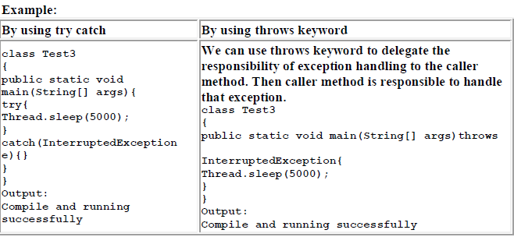
We can handle this compile time error by using the following 2 ways.
23

Slide 57
Note :
• Hence the main objective of "throws" keyword is to delegate the responsibility of
exception handling to the caller method.
• "throws" keyword required only checked exceptions. Usage of throws for
unchecked exception there is no use.
• "throws" keyword required only to convince complier. Usage of throws keyword
doesn't prevent abnormal termination of the program.
Example:
class Test
{
public static void main(String[] args)throws InterruptedException{
doStuff();
}
public static void doStuff()throws InterruptedException{
doMoreStuff();
}
public static void doMoreStuff()throws InterruptedException{
Thread.sleep(5000);
}
}
Output:
Compile and running successfully.
Hence recommended to use try-catch over throws keyword.
In the above program if we are removing at least one throws keyword then the program
won't compile.
24

Slide 58
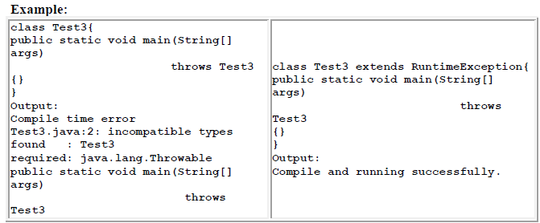
Case 1:
we can use throws keyword only for Throwable types otherwise we will get compile time
error saying incompatible types.
24

Slide 59
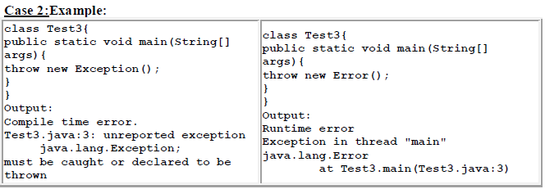
Case 3:
In our program with in the try block, if there is no chance of rising an exception then we
can't write catch block for that exception otherwise we will get compile time error
sayingexception XXX is never thrown in body of corresponding try statement. But this
rule is applicable only for fully checked exception.
25

Slide 60
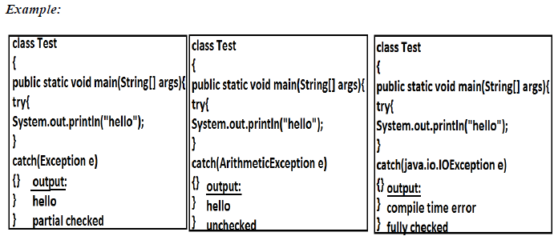
25

Slide 61
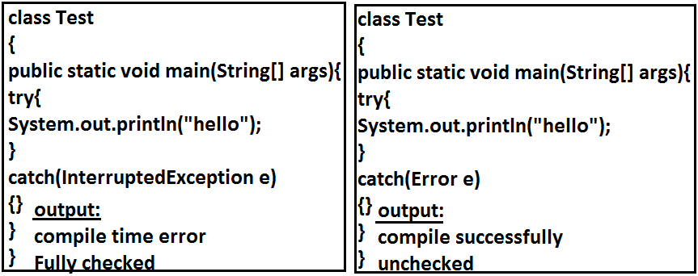
26

Slide 62
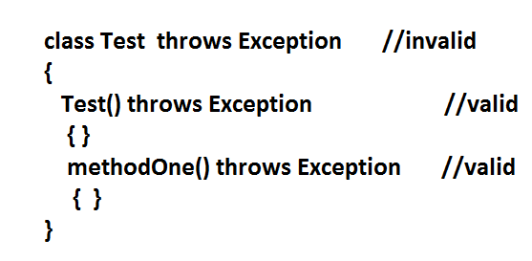
Case 4:
We can use throws keyword only for constructors and methods but not for classes.
26

Slide 63
Exception handling keywords summary
1. try: To maintain risky code.
2. catch: To maintain handling code.
3. finally: To maintain cleanup code.
4. throw: To handover our created exception object to the JVM manually.
5. throws: To delegate responsibility of exception handling to the caller method
21

Slide 64
Various possible compile time errors in exception handling
1. Exception XXX has already been caught.
2. Unreported exception XXX must be caught or declared to be thrown.
3. Exception XXX is never thrown in body of corresponding try statement.
4. Try without catch or finally.
5. Catch without try.
6. Finally without try.
7. Incompatible types.
found:Test
requried:java.lang.Throwable;
8. Unreachable statement.
26

Slide 65
Customized Exceptions (User defined Exceptions)

Slide 66
{
TooOldException(String s)
{
super(s);
}
}
class CustomizedExceptionDemo
{
public static void main(String[] args){
int age=Integer.parseInt(args[0]);
if(age>60)
{
throw new TooYoungException("please wait some more time.... u will get best
match");
}
else if(age<18)
{
Sometimes we can create our own exception to meet our programming requirements.
Such type of exceptions are called customized exceptions (user defined exceptions).
Example:
1. InSufficientFundsException
2. TooYoungException
3. TooOldException
Program:
//recommened to extend unchecked by extending runtime, otherwise compiler would give errors,it checks
class TooYoungException extends RuntimeException
{
TooYoungException(String s)
{
super(s);
}
}
class TooOldException extends RuntimeException

Slide 67
2)E:\scjp>java CustomizedExceptionDemo 27
You will get match details soon by e-mail
3)E:\scjp>java CustomizedExceptionDemo 9
Exception in thread "main" TooOldException:
u r age already crossed....no chance of getting married
at CustomizedExceptionDemo.main(CustomizedExceptionDemo.java:25)
throw new TooOldException("u r age already crossed....no chance of getting
married");
}
else
{
System.out.println("you will get match details soon by e-mail");
}}}
Output:
1)E:\scjp>java CustomizedExceptionDemo 61
Exception in thread "main" TooYoungException:
please wait some more time.... u will get best match
at CustomizedExceptionDemo.main(CustomizedExceptionDemo.java:21)
Note: It is highly recommended to maintain our customized exceptions as unchecked by
extending RuntimeException.
We can catch any Throwable type including Errors also.
27

Slide 68
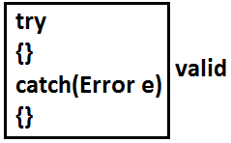
27

Slide 69
Top-10 Exceptions

Slide 70
Based on the person who is raising exception, all exceptions are divided into two types.
They are:
JVM Exceptions:
2) Programmatic exceptions:
JVM Exceptions:
The exceptions which are raised automatically by the jvm whenever a particular event
occurs, are called JVM Exceptions.
Example:
1) ArrayIndexOutOfBoundsException(AIOOBE)
2) NullPointerException (NPE).
Programmatic Exceptions:
The exceptions which are raised explicitly by the programmer (or) by the API developer
are called programmatic exceptions.
Example: 1) IllegalArgumentException(IAE).
28

Slide 71
Top 10 Exceptions :
1. ArrayIndexOutOfBoundsException:
It is the child class of RuntimeException and hence it is unchecked. Raised
automatically by the JVM whenever we are trying to access array element with
out of range index. Example:
class Test{
public static void main(String[] args){
int[] x=new int[10];
System.out.println(x[0]);//valid
System.out.println(x[100]);//AIOOBE
System.out.println(x[-100]);//AIOOBE
}
}
2. NullPointerException:
It is the child class of RuntimeException and hence it is unchecked. Raised
automatically by the JVM, whenever we are trying to call any method on null.
Example:
class Test{
public static void main(String[] args){
String s=null;
System.out.println(s.length()); //R.E: NullPointerException
}
}
29

Slide 72
3. StackOverFlowError:
It is the child class of Error and hence it is unchecked. Whenever we are trying to invoke recursive method call JVM will raise StackOverFloeError automatically.
Example:
class Test
{
public static void methodOne()
{
methodTwo();
}
public static void methodTwo()
{
methodOne();
}
public static void main(String[] args)
{
methodOne();
}
}
Output:
Run time error: StackOverFloeError
29

Slide 73
4. NoClassDefFoundError:
It is the child class of Error and hence it is unchecked. JVM will raise this error
automatically whenever it is unable to find required .class file. Example: java
Test If Test.class is not available. Then we will get NoClassDefFound error.
5. ClassCastException:
It is the child class of RuntimeException and hence it is unchecked. Raised
automatically by the JVM whenever we are trying to type cast parent object to
child type.

Slide 74
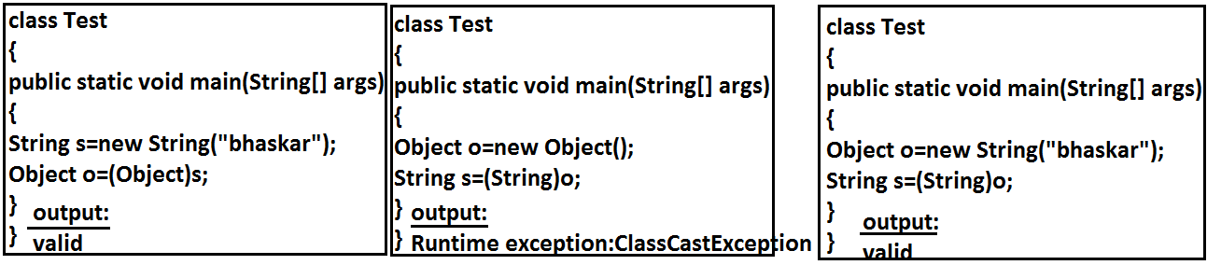

Slide 75
Example 2:
class Test{
static {
String s=null;
System.out.println(s.length());
}}
Output:
Runtime exception:
Exception in thread "main" java.lang.ExceptionInInitializerError
6. ExceptionInInitializerError:
It is the child class of Error and it is unchecked. Raised automatically by the
JVM, if any exception occurs while performing static variable initialization and
static block execution.
Example 1:
class Test{
static int i=10/0;
}
Output:
Runtime exception:
Exception in thread "main" java.lang.ExceptionInInitializerError
30

Slide 76
8. NumberFormatException:
It is the child class of IllegalArgumentException and hence is unchecked. Raised
explicitly by the programmer or by the API developer to indicate that we are
attempting to convert string to the number. But the string is not properly formatted.
7. IllegalArgumentException:
It is the child class of RuntimeException and hence it is unchecked. Raised
explicitly by the programmer (or) by the API developer to indicate that a method
has been invoked with inappropriate argument.
Example:
class Test{
Example:
class Test{
public static void main(String[] args){
int i=Integer.parseInt("10");
int j=Integer.parseInt("ten");
}}
Output:
Runtime Exception
Exception in thread "main" java.lang.NumberFormatException: For input
string: "ten"
public static void main(String[] args){
Thread t=new Thread();
t.setPriority(10);//valid
t.setPriority(100);//invalid
}}
Output:
Runtime exception
Exception in thread "main" java.lang.IllegalArgumentException.
30

Slide 77
9. IllegalStateException:
It is the child class of RuntimeException and hence it is unchecked. Raised
explicitly by the programmer or by the API developer to indicate that a method
has been invoked at inappropriate time.
Example:
Once session expires we can't call any method on the session object otherwise we
will get IllegalStateException
10. AssertionError:
It is the child class of Error and hence it is unchecked. Raised explicitly by the
programmer or by API developer to indicate that Assert statement fails.
Example:
assert(false);
HttpSession session=req.getSession();
System.out.println(session.getId());
session.invalidate();
System.out.println(session.getId()); // illgalstateException
31

Slide 78
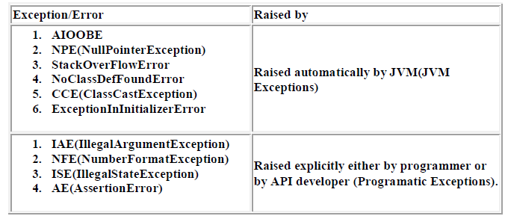

Slide 79
1.7 Version Enhansements

Slide 80
As part of 1.7 version enhancements in Exception Handling the following 2 concepts introduced
1. try with resources
2. multi catch block
problems in this approach :
• Compulsory programmer is required to close all opened resources with increases
the complexity of the programming
• Compulsory we should write finally block explicitly which increases length of the
code and reviews readability.
1.try with resources
Untill 1.6 version it is highly recommended to write finally block to close all resources
which are open as part of try block.
To overcome these problems Sun People introduced "try with resources" in 1.7
version.
BufferedReader br=null;
try{
br=new BufferedReader(new FileReader("abc.txt"));
//use br based on our requirements
}
catch(IOException e) {
// handling code
}
finally {
if(br != null)
br.close();
}
32

Slide 81
try(BufferedReader br=new BufferedReader(new FileReader("abc.txt")))
{
use be based on our requirement, br will be closed automatically ,
Onec control reaches end of try either normally
or abnormally and we are not required to close explicitly
}
catch(IOException e) {
// handling code
}
The main advantage of "try with resources" is
the resources which are opened as part of try block will be closed automatically
Once the control reaches end of the try block either normally or abnormally and hence
we are not required to close explicitly so that the complexity of programming will be
reduced.It is not required to write finally block explicitly and hence length of the code
will be reduced and readability will be improved.
33

Slide 82
Conclusions:
1. We can declare any no of resources but all these resources should be seperated with
;(semicolon)
try(R1 ; R2 ; R3)
{
-------------
-------------
}
2. All resources should be AutoCloseable resources. A resource is said to be auto
closable if and only if the corresponding class implements the java.lang.AutoCloseable
interface either directly or indirectly.
All database related, network related and file io related resources already
implemented AutoCloseable interface. Being a programmer we should aware and we
are not required to do anything extra.
3. All resource reference variables are implicitly final and hence we can't perform
reassignment with in the try block.
try(BufferedReader br=new BufferedReader(new FileReader("abc.txt"))) ;
{
br=new BufferedReader(new FileReader("abc.txt"));
}
output :
CE : Can't reassign a value to final variable br
4.Untill 1.6 version try should be followed by either catch or finally but 1.7 version we can take only try with resource without catch or finally
try(R)
{ //valid
}
33

Slide 83
}
catch(ClassCastException e) {
System.out.println(e.getMessage());
}
catch(IOException e) {
System.out.println(e.getMessage());
}
5.The main advantage of "try with resources" is finally block will become dummy
because we are not required to close resources of explicitly.
Until 1.6 version ,Eventhough Multiple Exceptions having same handling code we have
to write a separate catch block for every exceptions, it increases length of the code and
reviews readability
To overcome this problem Sun People introduced "Multi catch block" concept in 1.7
version.
The main advantage of multi catch block is we can write a single catch block , which can
handle multiple different exceptions
try{
-----------------
-----------------
}
catch(ArithmeticException e) {
e.printStackTrace();
}
catch(NullPointerException e) {
e.printStackTrace();

Slide 84
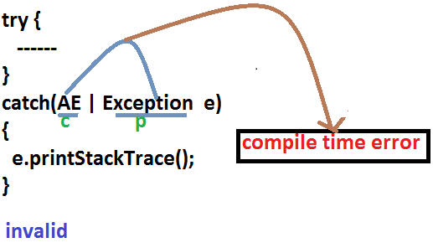
try{
-----------------
-----------------
}
catch(ArithmeticException | NullPointerException e) {
e.printStackTrace();
}
catch(ClassCastException | IOException e) {
System.out.println(e.getMessage());
}
In multi catch block, there should not be any relation between Exception types(either
child to parent Or parent to child Or same type , otherwise we will get Compile time
error )
34

Slide 85
class Test
{
public static void main(String[] args){
try {
System.out.println(10/0);
}
catch(ArithmeticException e) {
throw new NullPointerException();
}
}
}
output:
RE:NPE
Exception Propagation :
With in a method if an exception raised and if that method doesn't handle that
exception, then Exception object will be propagated to the caller then caller method is
responsible to handle that exceptions. This process is called Exception Propagation
Rethrowing an Exception :
To convert the one exception type to another exception type , we can use rethrowing
exception concept.
35

Slide 86

Thanks!

